Slide 1
INDUSTRY ORIENTED PROJECT TRAINING PRESENTATION
HOSPITAL MANAGEMENT SYSTEM
BACHELOR OF TECHNOGY
In
Computer Science & Engineering
SUBMITTED BY :
DIVANSHU SHARMA
1535450
CSE B

Slide 2
INTRODUCTION TO PROJECT
PURPOSE
A Hospital Management System is used to maintain the data of the patient and their diagnosis details and the physician details . This system helps to ease the work load of the hospital as in earlier days everything was manual which takes a lot of time and effort.
The inspiration of this project is to improve Hospital System in India and to develop a hospital management system which focuses on making an online system that is accessible for the admin to manage the data. Admin can directly put information regarding their previous patient and physician , including their history and future details, in order to easily schedule their appointments. The system is also developed for the requisites, who are the main authority in the system.

Slide 3
INTRODUCTION TO PROJECT
OBJECTIVES
The goal of the project is to develop a web application for hospital to manage information about their patients and physician. The main objectives of this website development can be defined as follows:
1. To develop a system that provides functions to support admin to view and manage patient information conveniently.
2. To maintain records of patients, physician information and diagnosis details in a centralized database system.
3. To inform patient result after their diagnosis.
4. To support searching, matching and requesting for physician provided to the patient.

Slide 4
PROJECT OVERVIEW
PROBLEM INTRODUCTON
Patient profile accessibility
The patient’s information can only be updated by the administrators of the hospital. A patient can update their information by calling, faxing, e-mailing, but not by themselves. This is a waste of time just for updating a piece of information and it may be troublesome for some patient.
Physician profile accessibility
The physician’s information can only be updated by the administrators of the hospital. A physician can update their information by calling, faxing, e-mailing, but not by themselves. This is a waste of time just for updating a piece of information and it may be troublesome for some physician.

Slide 5
Diagnosis record accessibility
The patient ID card is the only tangible evidence that contains the patient’s recent
diagnosis records, if the card gets lost, patients may find it difficult to schedule them
next appointment since they are not able to see the last time they had diagnosed
in the hospital.
Diagnosis result notifications
After the process of diagnosis, the patient will receive a card that only
contains their name and diagnosis. They will not be notified of their diagnosis
unless they request that information from the hospital.
Diagnosis management
Hospitals are required to maintain account of patient in the inventory. This
increases with each patient recorded in our system, and decreases as they
are checked out upon hospital requests. Our system will need to keep the
information up-to-date to ensure correctness of the inventory.

Slide 6
PROJECT OVERVIEW
PROJECT SCOPE
Registration
This function allows the admin and requisite to register as a user to interact
with the system. The system requires the user to login before viewing and editing
any information.
View information online
Admin and requisite are allowed to view their blood donation information online by their given
account.
Data input
The admin’s and requisite’s information of patient and requirement will be added and changes would
occur on the homepage.

Slide 7
Recording diagnosis records
The system is able to record data of the patients in the database with their slot booking in particular hospital.
Diagnosis requests
The user can request for the diagnosis if that particular request is not already available in the database.

Slide 8
PROJECT OVERVIEW
MODULES
The entire project mainly consists of modules:
Admin Module
Patient’s Module
Physician’s Module
Diagnosis Module
About Module

Slide 9
PROJECT OVERVIEW
MODULES
Admin Module
Register for new admin.
Login with credentials.
Enter details of admin.
Carefully save all the data of user into the database.
Patient’s Module
Admin will register the new patient in the system.
Enter the details of the patient.
Book a slot in the hospital for diagnosis.

Slide 10
Physician Module
Admin will register the new physician.
Admin will add new physician in the database.
Admin will schedule the timings for the physician.
Feedback Module
Interested user can share their feedback and will be displayed on the home page.
About Module
About the project and developing team.

Slide 11
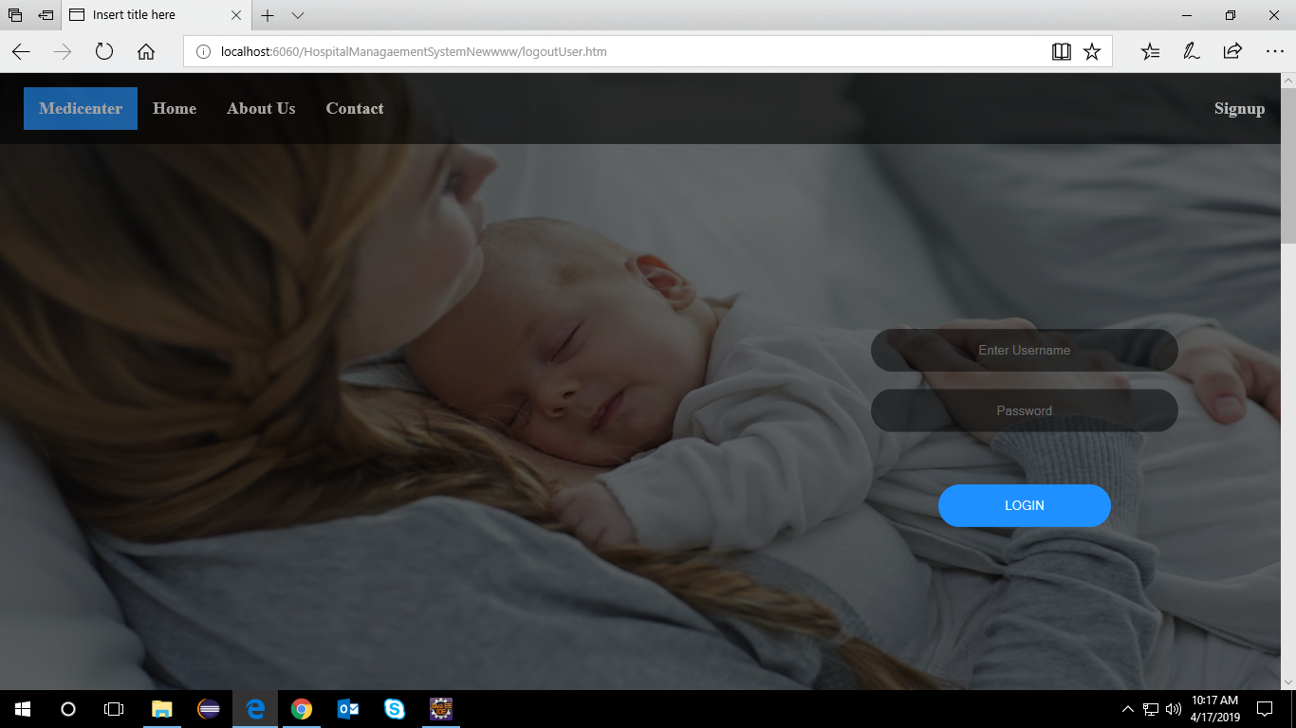
SCREENSHOTS

Slide 12
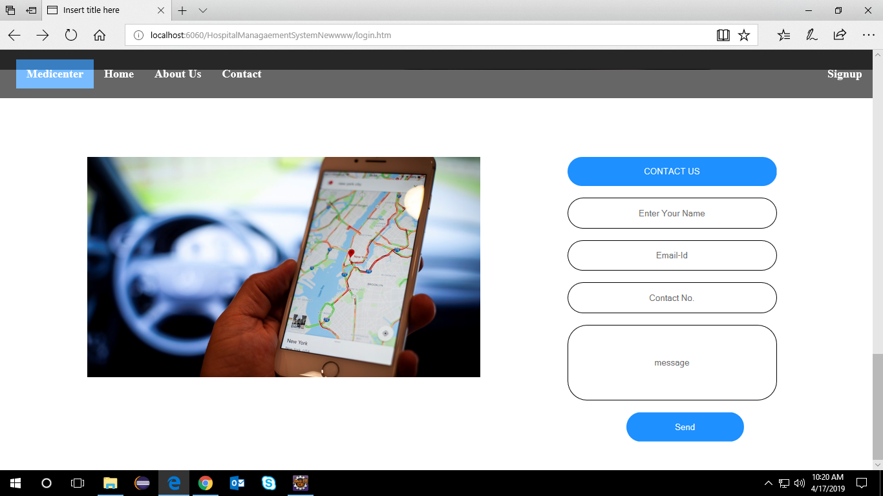
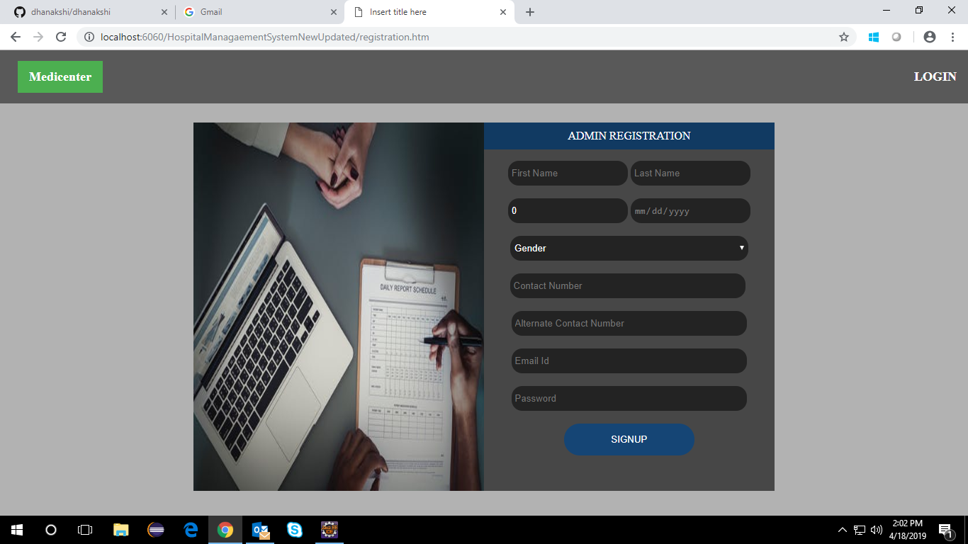

Slide 13
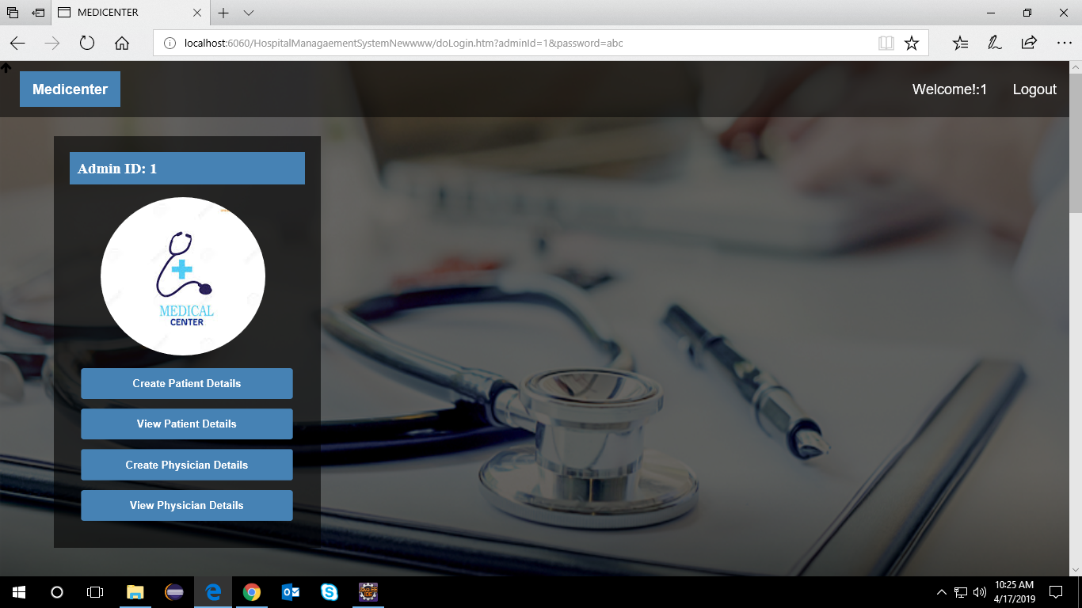

Slide 14
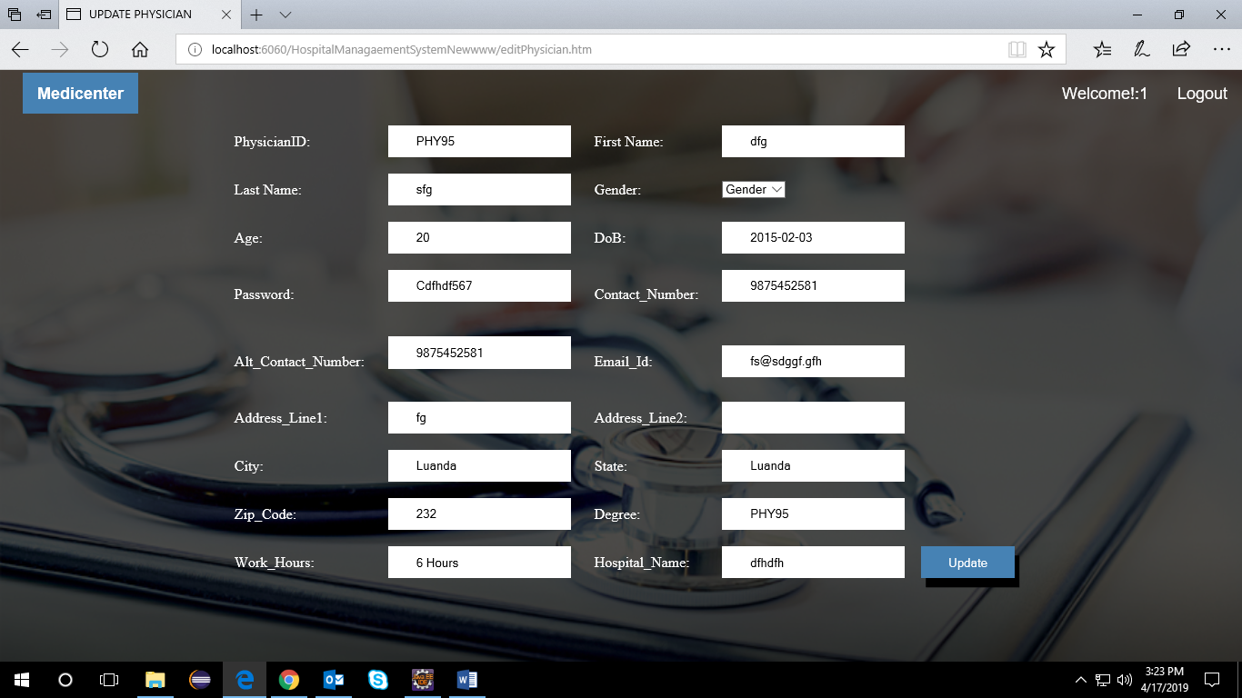

Slide 15
THANK YOU

